Slide 1

MATTISSE: A Biodegradable Scaffold for Breast Tissue Regeneration in Post-Mastectomy Breast Cancer Patients
Emma Bertram
585.729 Cell and Tissue Engineering Fall 2022

Slide 2
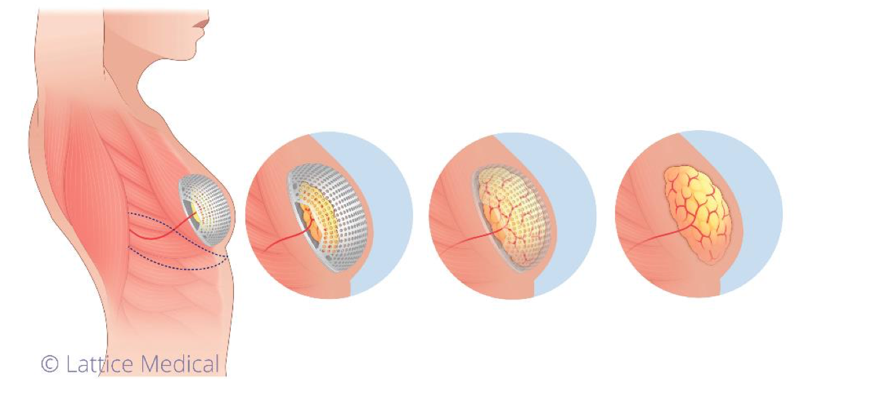
Topic and Problem Statement
MATTISSE by Lattice Medical
Bio-resorbable Tissue Engineering Chamber (TEC)
3D printed matrix
Adipose tissue reconstruction
Reference: “Press Report - LATTICE MEDICAL Announces the Success of the First Breast Reconstruction Operation with the MATTISSE Implant.” Lattice Medical, https://www.lattice-medical.com/wp-content/uploads/2022/09/CP-LATTICE-MEDICAL-FIH-FIRST-PATIENT-WITH-MATTISSE-UK.pdf.

Slide 3
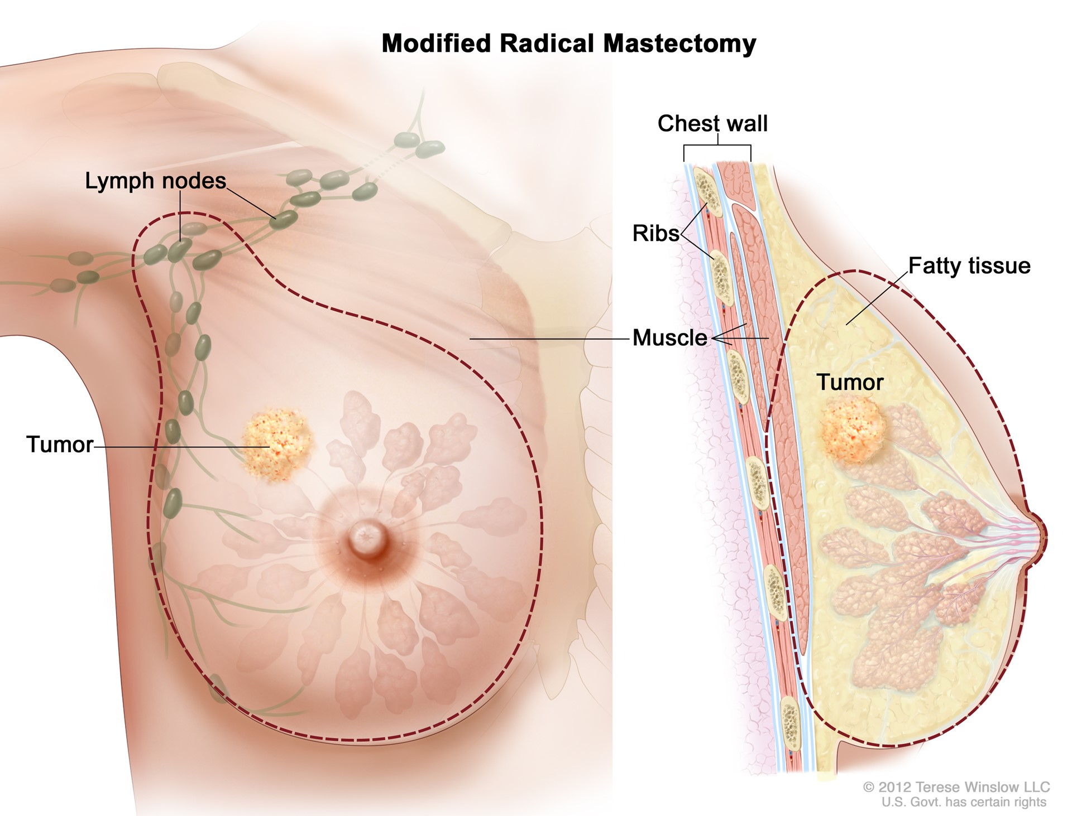
Problem Description and Motivation
2.3 million breast cancer patients
270,000 Americans annually
Mastectomy surgery
Estimated market: $648 million yearly
References: “Mastectomy.” ACS, https://www.facs.org/for-patients/home-skills-for-patients/breast-cancer-surgery/understanding-your-operation/mastectomy/.

Slide 4
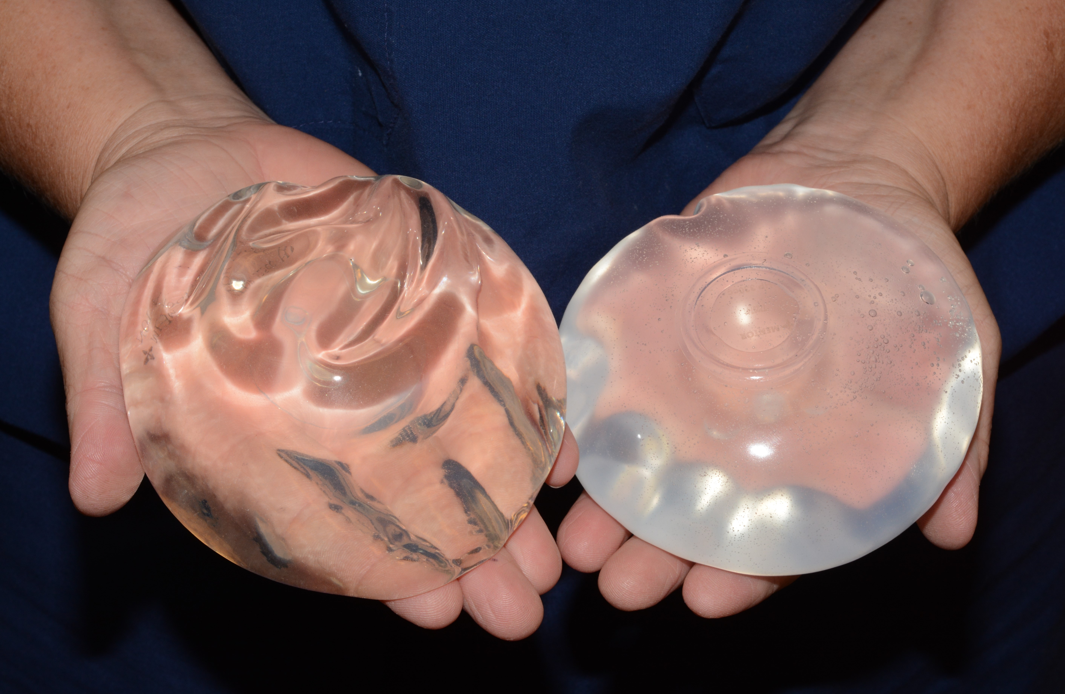
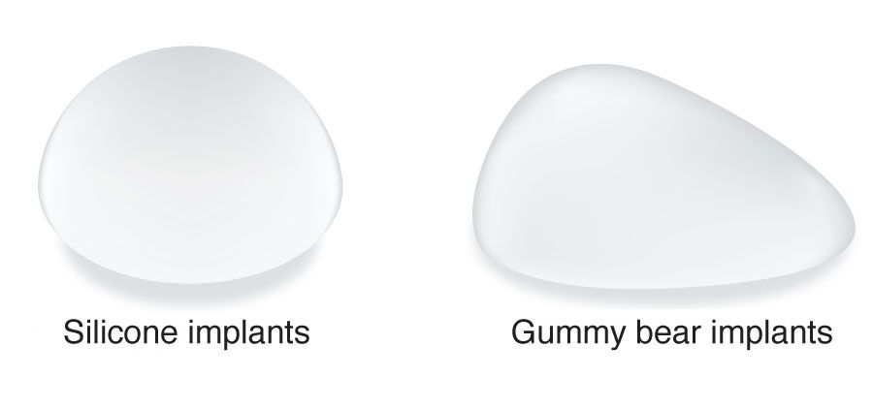
Solution Landscape
References: “Saline vs Silicone Implants for Breast Augmentation.” Carmel Cosmetic and Plastic Surgeons, https://www.carmelcosmeticsurgeons.com/blog/2019/09/05/saline-vs-silicone-implants-for-201521.
“Gummy Bear Implants Offer a Stable Shape and Added Safety.” Oren Z. Lerman, MD, https://www.orenlerman.com/procedures/breast-implants/gummy-bear.

Slide 5
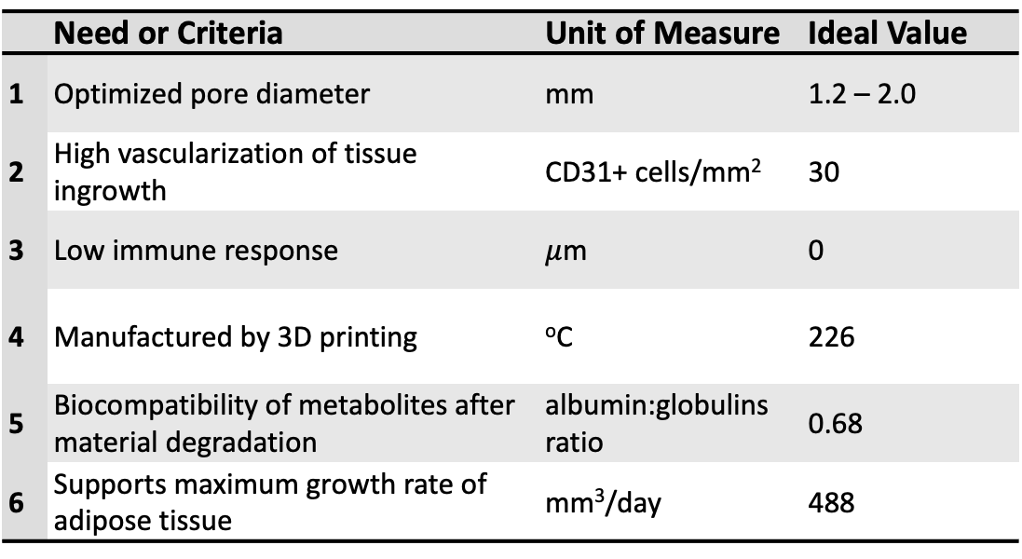
Product Description and Specifications
 | Need or Criteria | Unit of Measure | Ideal Value
1 | Optimized pore diameter | mm | 1.2 – 2.0
2 | High vascularization of tissue ingrowth | CD31+ cells/mm² | 30
3 | Low immune response | $μ$m | 0
4 | Manufactured by 3D printing | ºC | 226
5 | Biocompatibility of metabolites after material degradation | albumin:globulins ratio | 0.68
6 | Supports maximum growth rate of adipose tissue | mm³/day | 488
References: Faglin, Pierre, et al. “Rationale for the Design of 3D-Printable Bioresorbable Tissue-Engineering Chambers to Promote the Growth of Adipose Tissue.” Scientific Reports, Vol. 10, No. 1, 2020, https://doi.org/10.1038/s41598-020-68776-8.

Slide 6
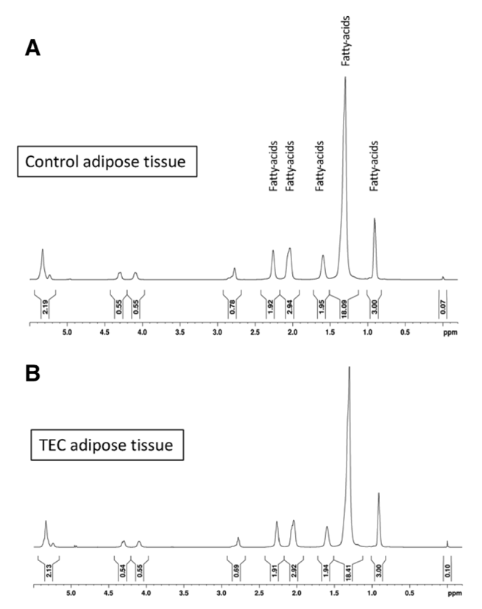
Verification and Validation Studies
Animal models in rats and pigs
¹H-NMR spectroscopy spectrums
Verified adipose tissue type
References: Faglin, Pierre, et al. “Rationale for the Design of 3D-Printable Bioresorbable Tissue-Engineering Chambers to Promote the Growth of Adipose Tissue.” Scientific Reports, Vol. 10, No. 1, 2020, https://doi.org/10.1038/s41598-020-68776-8.

Slide 7
Conclusions
MATTISSE
Biocompatible
Temporary
3D Printed
Adipose Tissue Regeneration
References: “Soft Tissue Reconstruction.” Lattice Medical, https://www.lattice-medical.com/.

Slide 8
References
Faglin, Pierre, et al. “Rationale for the Design of 3D-Printable Bioresorbable Tissue-Engineering Chambers to Promote the Growth of Adipose Tissue.” Scientific Reports, Vol. 10, No. 1, 2020, https://doi.org/10.1038/s41598-020-68776-8.
“Gummy Bear Implants Offer a Stable Shape and Added Safety.” Oren Z. Lerman, MD, https://www.orenlerman.com/procedures/breast-implants/gummy-bear.
“Soft Tissue Reconstruction.” Lattice Medical, https://www.lattice-medical.com/.
“Mastectomy.” ACS, https://www.facs.org/for-patients/home-skills-for-patients/breast-cancer-surgery/understanding-your-operation/mastectomy/.
“Press Report - LATTICE MEDICAL Announces the Success of the First Breast Reconstruction Operation with the MATTISSE Implant.” Lattice Medical, https://www.lattice-medical.com/wp-content/uploads/2022/09/CP-LATTICE-MEDICAL-FIH-FIRST-PATIENT-WITH-MATTISSE-UK.pdf.
“Saline vs Silicone Implants for Breast Augmentation.” Carmel Cosmetic and Plastic Surgeons, https://www.carmelcosmeticsurgeons.com/blog/2019/09/05/saline-vs-silicone-implants-for-201521.

